Slide 1

Volumetric Left Ventricle segmentation of MPI SPECT IMAGES with self-supervised learning Technical details
Author: Kristóf Máté Horváth
Supervisor: Ádám István Szűcs

Slide 2
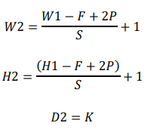
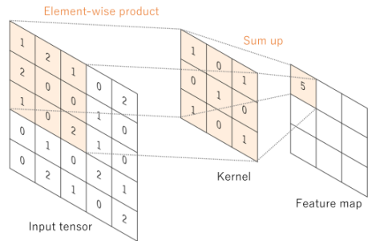
Convolution
For every possible location on the input tensor the element-wise dot product is computed with the kernel to produce feature maps
The parameters of the kernel are learnable weights
Hyperparameters: kernel size, stride, padding, number of kernels
Stride > 1 – down-sampling purpose
Translation invariant with respect to its input, due to its weight sharing properties – the same kernel is applied to every position on the input data, which reduces the complexity of the model.

Slide 3
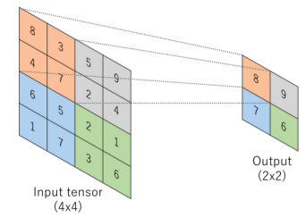
Max-pooling
Serves as down-sampling layer to decrease spatial dimensions of the input data.
Partitions the input tensor into non-overlapping subregions, called patches. For each patch, the max-pooling operation takes the maximum of the values and produces an output value at a certain index for the output tensor.
A 2x2 kernel reduces the spatial dimensions in each direction by a factor of 2.

Slide 4
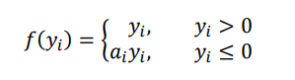
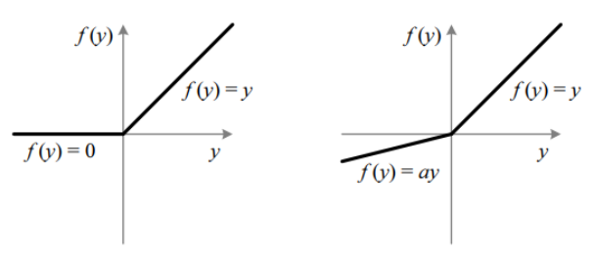
Activation functions
Purpose of activation functions is to add non-linearity to the neural network.
Activation functions facilitate the approximation of non-linear functions, or in other words the learning of highly complex tasks.
Rectified Linear Unit (ReLU) :
a_{i} is a coefficient that controls the slope of the negative part of the function. If it is zero, the function is called ReLU. Index i indicates different channels.
Leaky ReLU:
a_{i} is a small number that avoids zero gradients
Parametric ReLU (PReLU):
a_{i} is a learnable weight

Slide 5
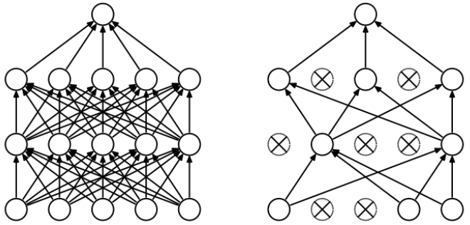
Dropout
Regularization technique which facilitates the training of deep neural networks.
Prevents overfitting and effectively combines many different neural network architectures – the trained model can be regarded as a model of ensembles.
For each neuron, there is a fixed probability p to be retained during each epoch. If the neuron is not retained, its input and output connections are temporarily dropped.
At test time the outgoing weights of each neuron is multiplied by the retention probability p to ensure that the expected output of the hidden unit is the same.
Results in much lower generalization error – prevents the co-adaptation of the neurons, meaning that the neurons are only capable to effectively detect features in the presence of each other.

Slide 6
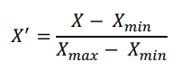
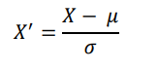
Normalization layers
Data normalization transforms the underlying features in a way to be distributed in the same range, typically in a small interval of [-1, 1] or [0, 1] – features on different scales influences the training of models differently.
Min-Max scaling transforms the data set into a range of [0, 1].
Standardization / Z-score normalization transforms the data set by subtracting the mean and dividing by the standard deviation of the data set from each sample. The standardized data set has approximately zero mean and unit variance.
Training of neural networks converges faster towards an optimal loss value when the inputs are linearly transformed to have zero means and unit variances and when the features are decorrelated.

Slide 7
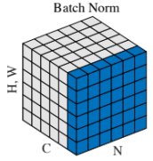
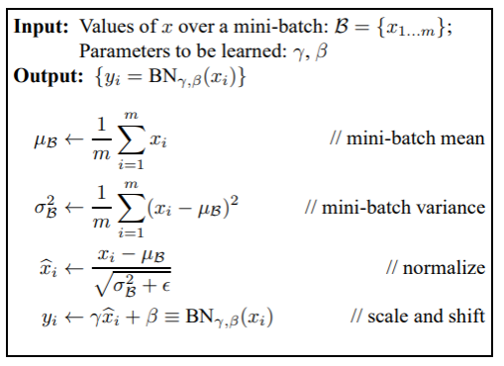
Batch Normalization
During training of deep neural networks, the distribution of each layer’s inputs changes, which can cause the training to diverge while at the same time it also slows down by a great margin.
Given a layer of a deep neural network, small changes to the preceding layers can have a huge impact on the distribution of the inputs for the given layer and this is amplified as the layer is located deeper in the network.
The layers continuously need to adapt to the distribution changes of each layer’s input data – Internal Covariate Shift.
Batch Normalization (BN) stabilizes the training and facilitate the application of larger learning rates, which speeds up the convergence. BN also affects the gradient flow of the network, because the gradients are less dependent on the scale of the parameters. BN also reduces the rate of the dropout that need to be applied – it has regularization characteristics.

Slide 8
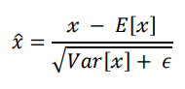
Batch-normalization
During training, the whole training data set running mean and variance are computed through moving averages. During inference time, instead of BN(x), the data set statistics are applied to normalize each training sample.
BN achieves that in each layer the neural network produces activations that always closely approximates the desired Gaussian distribution, which consequently stabilizes and speeds up the training.

Slide 9
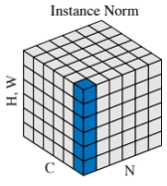
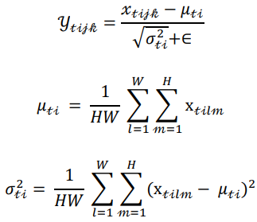
Instance normalization
Batch size of T, and in each batch, an input image has C channels, and its width and height dimensions are W and H.
Instance Normalization (IN) computes the mean and standard deviation along the W and H dimensions – it normalizes each training sample independently.
It is beneficial to apply it for large volume segmentations.
IN layers are kept during inference time in contrast to BN layers.

Slide 10
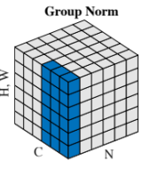
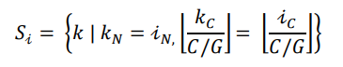
GROUP normalization
Sometimes the training batch size should be small because of memory limits, such in object detection and segmentation tasks. The computation of BN becomes inaccurate and introduces rapidly increasing error as the batch size becomes smaller.
Group Normalization (GN) computes the mean and variance for normalization by dividing the channels into groups and normalizes the features within each group independently.
S_{i} is the set of pixels in each group
G is a hyperparameter and represents the number of groups
C/G is the number of channels within each group
The mean and standard deviation are computed along the axes of H, W and C/G channels.

Slide 11
Receptive field of convolutional neural networks
Understanding the Receptive Field (RF) of CNNs is essential to design architectures that can perform well on certain tasks.
In object-detection tasks, if the span of a convolutional feature is small, the network might not be able to detect small objects and vice-versa.
RF associates an output feature with an input region that produced the certain output feature.
In other words, the computation of RF aims to measure the extent of the effect of the input signals on the output features, while it also traces back the output features to the inputs that produced them.

Slide 12
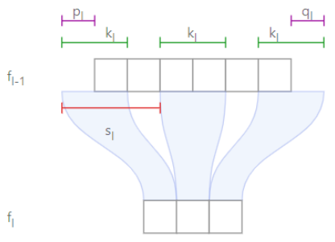
Receptive field of convolutional neural networks
𝑓𝑙 ∈ ℝ ^{ℎ𝑙×𝑤𝑙×𝑑l} is a feature map of a fully-convolutional network (FCN). Index l specifies that the feature map is the output of the lth layer, h_{l}, w_{l} and d_{l} represent the height, width and depth dimensions.
The input of the FCN is denoted by f₀ and the output feature map of the last layer is denoted by f_{L}, thus the FCN has L layers.
Additional parameters are k_{l}, s_{l}, p_{l} and q_{l}, which represent the kernel size, stride and padding of the left and right side of the input feature map, respectively.
The image shows how one position of the kernel affects a certain position of the output feature map.

Slide 13
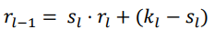
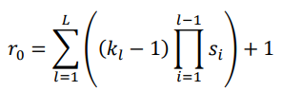
Receptive field of convolutional neural networks
The size of the RF of the final output layer f_{L} is denoted by r_{l}.
To generate one feature in f_{L} ,there are r_{l} number of features that contribute to the feature map f_{l}.
Recurrence equation for single-path networks, first-order, non-homogeneous equation with variable coefficients.
The recurrence equation can be solved in terms of k_{l}’s and s_{l}’s.
When all kernels are of size 1, the RF is also of size 1.
When all strides are 1, then the RF is the sum of (k_{l}-1) over all layers plus 1.
When the stride is greater than 1 for a certain layer, for consecutive layers the region of the RF increases proportionally.

Slide 14
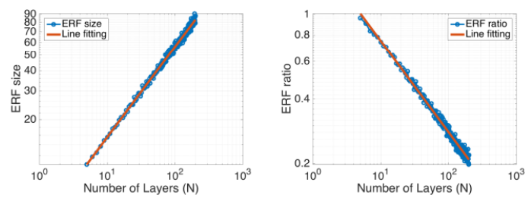
Effective receptive field of convolutional neural networks
The Effective Receptive Field (ERF) occupies a fraction of the theoretical RF and it has a Gaussian distribution.
The size of the theoretical RF increases linearly as more layers are stacked together to make the network deeper, while sub-sampling increases the size of the RF multiplicatively.
It was discovered that not all values of the RF contribute equally to the output unit’s response.
Values at the centre of the RF have a much larger impact.
The ERF grows linearly by √N, while the relative ratio of the ERF over the theoretical RF decreases by 1/√𝑁, with respect to the number of convolutional layers N.

Slide 15
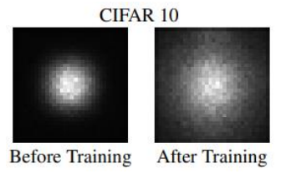
Effective receptive field of convolutional neural networks
It was also observed that Skip Connections have a decreasing effect on the ERF.
However, it was also observed that the initially small ERF at the beginning of the training evolves into a much larger one during the training.

Slide 16
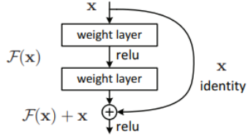
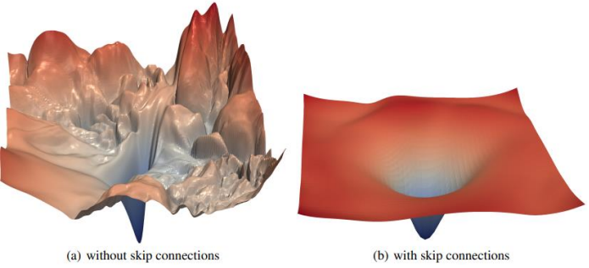
Skip connections
As the neural network grows deeper, the training error increases and its performance degrades.
The deep residual framework addresses this problem with Residual Blocks, which contain identity mappings through skip connections.
Skip connection performs identity mapping and its output is added to the stacked layers through element-wise addition.
Methods were developed to effectively visualize the loss landscape and it was observed experimentally that architectures that include skip connections produce smoother, convex loss landscapes instead of chaotic ones.
Residual connections prevent the explosion of non-convexity as the network grows deeper and results in lower generalization error.

Slide 17
Loss functions
Loss function is a method to evaluate the performance of a machine learning model. Also called cost function or objective function.
The error between the true labels and the predictions is computed with the loss function.
The goal of the model is to minimize the objective function with respect to the parameters of the model.
Binary Cross-Entropy
Measures the difference between two probability distributions for a random variable.
Commonly used for classification – segmentation is a pixel level classification.
Best use-case is when the data set is balanced.
Weighted Binary Cross-Entropy
To tune the number of false negatives and false positives, when the data set is skewed.

Slide 18
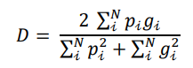
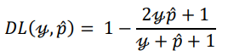
Dice loss
Dice Score Coefficient (DSC)
Measure of overlap between two samples.
DSC is subtracted from 1 to formulate a loss function that can be minimized.
+1 is added to handle edge case scenarios.

Slide 19
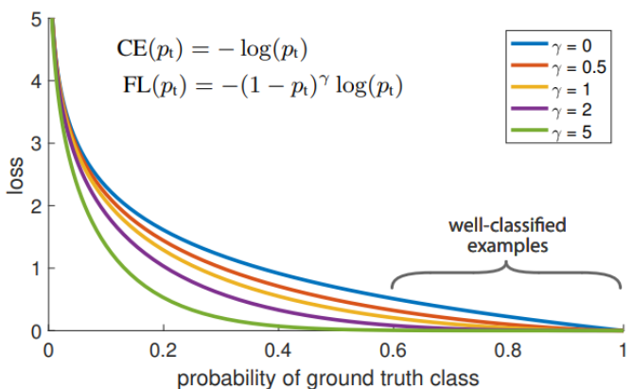
Focal loss
Developed to handle extreme class imbalance.
Focal Loss (FL) reshapes the standard Cross-Entropy (CE) loss in a way that it down-weights the loss for easy and well-classified examples. A dynamically scaled CE loss function where the scaling factor decays to zero as the confidence in the correct class increases, which helps the model to focus on the hard examples.
γ parameter controls the magnitude of the relative loss between the well-classified easy examples and incorrectly classified hard examples.
γ = 0, FL becomes CE.
As γ increases, the ratio of losses corresponding to the low and high confidence predictions increases.

Slide 20
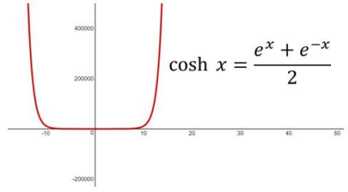
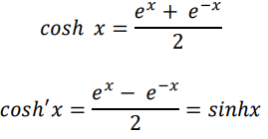
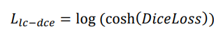
Log-cosh dice loss
Log-Cosh Dice loss aims to preserve the features properties of the Dice loss function while it also eliminates its non-convex nature – facilitates the convergence towards optimal results more easily.
The logarithm is taken to better constrain the infinite range of the cosh(x) function.

Slide 21
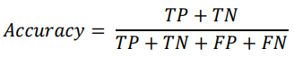
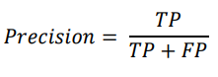
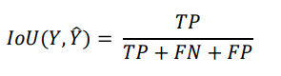
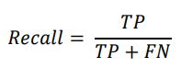
metrics
Metrics are functions which take the predictions of a machine learning model and the true labels as input and they produce a value which describe the performance of the model from different statistical aspects.
Many classification metrics can be applied to segmentation as well, as segmentation is a pixel-level classification problem.
Ratio of correctly classified examples over the number of predictions.
Can be very misleading when the data set is imbalanced, as the majority class can have a higher influence on the model.
Ratio of correctly classified positive examples over the number of predicted positives.
How many of the positives examples are found by the model? Can be optimized when the data set is imbalanced.
Intersection over Union – measures the area of overlap between the predictions and the true labels.

Slide 22
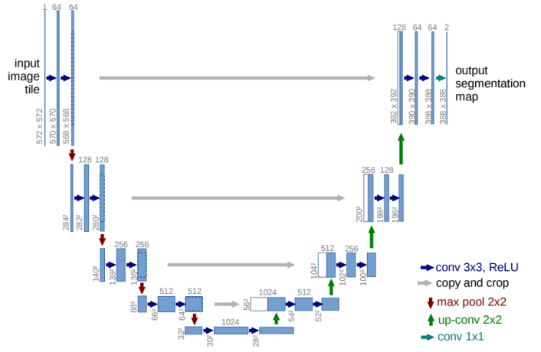
U-Net for image segmentation

Slide 23
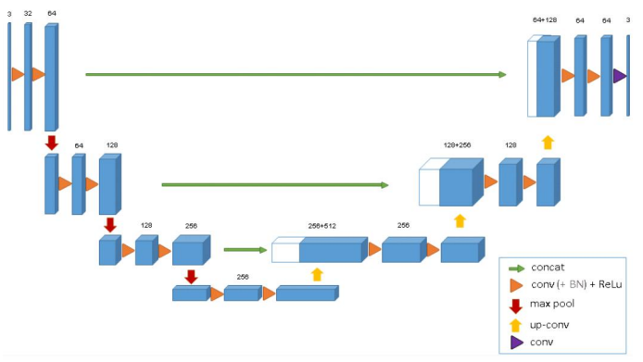
3D U-Net for volumetric segmentation

Slide 24
Thank you for your attention!

